Slide 1


Building a Small App for Visualizing Monthly Expenses
PRESENTED BY
2303811724321115 – SURYA S
1
29/05/2025

Slide 2

PRESENTATION OVERVIEW
Objective
Problem Statement or Definition
Existing System And Its Drawback
Proposed System And Its Advantages
Dataflow Diagram
Architecture Diagram
Modules Splitup
Modules Description And Explanation
Screenshots
Conclusion
2
29/05/2025

Slide 3
OBJECTIVE
The Budget Tracking System aims to help users maintain financial discipline by accurately categorizing their expenses. It provides real-time monitoring, allowing users to track their spending and stay within budget limits.
To create an easy-to-use app for uploading and visualizing monthly expenses.
To provide interactive charts that help users understand and manage their spending better.
3
29/05/2025

Slide 4
PROBLEM STATEMENT OR DEFINITION
Users often misclassify their expenses, leading to inaccurate budget tracking and poor financial planning. Handling large datasets efficiently without compromising app speed and responsiveness.
Users cannot track their financial status in real-time, leading to overspending or missed opportunities to save.
Users may upload CSV files with inconsistent formats, causing errors.
4
29/05/2025

Slide 5
EXISTING SYSTEM AND ITS DRAWBACK
Existing methods mainly use manual spreadsheets or basic apps that require constant data entry, making tracking tedious and error-prone. These tools often provide limited, static visualizations, hindering effective analysis of spending patterns
LIMITATIONS :
Manual entry is time-consuming and error-prone
Limited support for uploading external CSV data
Lack of interactive and customizable visualizations
Inability to view real-time updates based on user input
7
29/05/2025

Slide 6
PROPOSED SYSTEM
The system allows users to upload CSV files quickly, simplifying data input for expense tracking.
It provides interactive bar and pie charts to visually analyze spending patterns effectively.
Visualizations update dynamically in real-time as users change inputs or data.
The intuitive interface enhances user experience, making expense management easier and more efficient.
5
29/05/2025

Slide 7
ADVANTAGES
Simplicity
Interactivity
Flexibility
Real-time
Visualization
6
29/05/2025

Slide 8
DATAFLOW DIAGRAM
user
Uploads a csv file
file upload
Input table
creator
Chart type selection
Plot renderer
(ggplot2)
8
29/05/2025

Slide 9
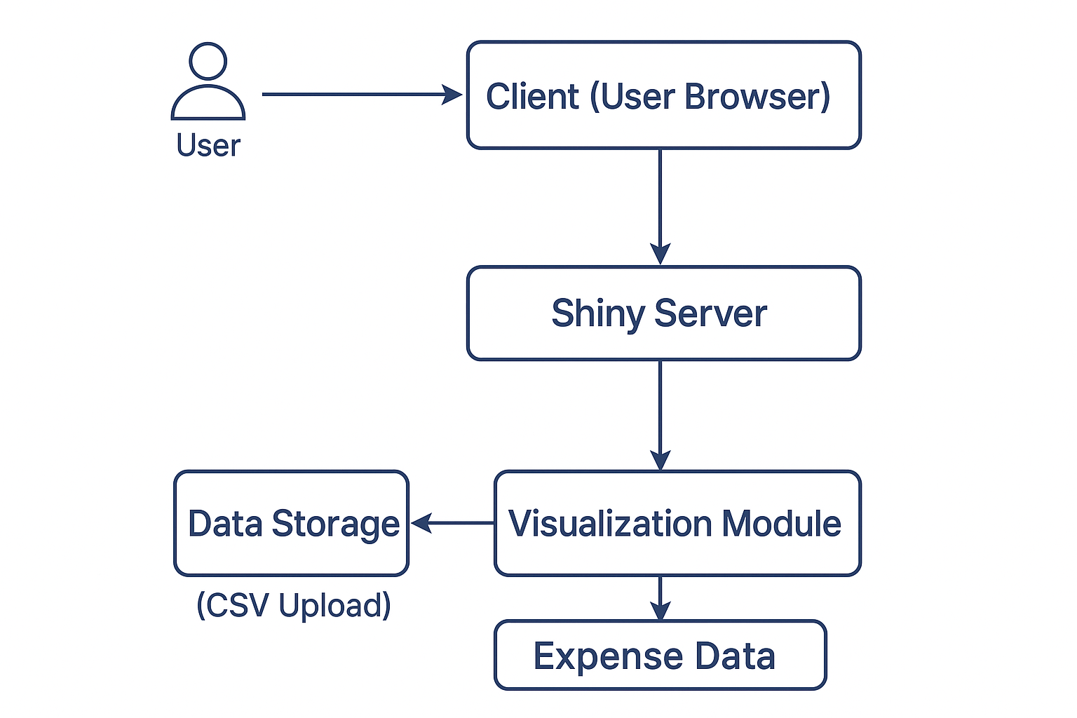
ARCHITECTURE DIAGRAM
9
29/05/2025

Slide 10
MODULES SPLITUP
File Upload Module
Chart Type Selection Module
Input Table Module
Reactive Rendering Module
User Interface Module
10
29/05/2025

Slide 11
MODULES DESCRIPTION AND EXPLANATION
File Upload Module :
Allows users to upload CSV files containing monthly expense data.
Chart Type Selector :
Enables users to choose between bar chart and pie chart views.
Reactive Rendering Module :
Listens to user input and updates plots automatically.
User Interface Module :
Organizes the layout using panels and controls.
Input Table Module :
Displays the uploaded data in a clear and interactive table.
11
29/05/2025

Slide 12
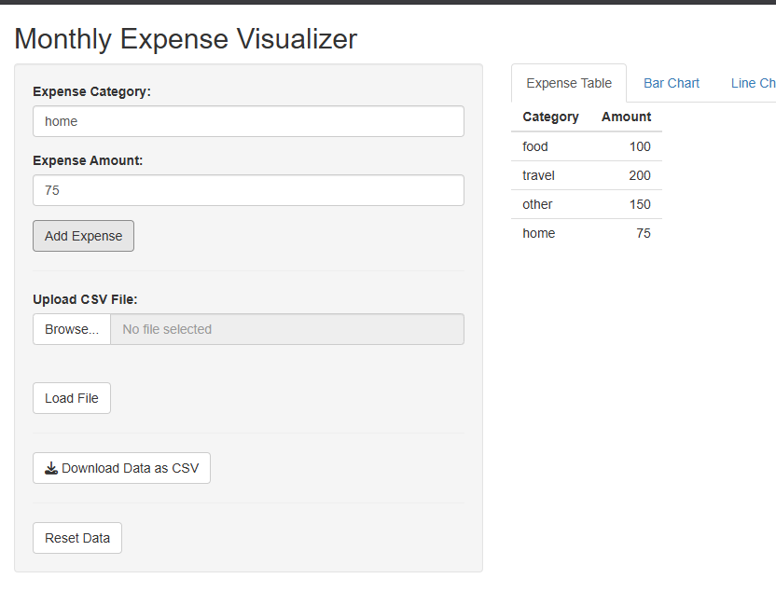
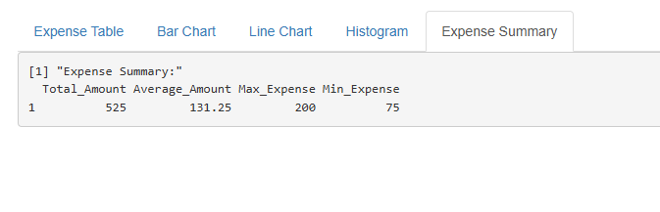
SCREENSHOTS
INPUT TABLE OR CSV
EXPENSE SUMMARY
12
29/05/2025

Slide 13
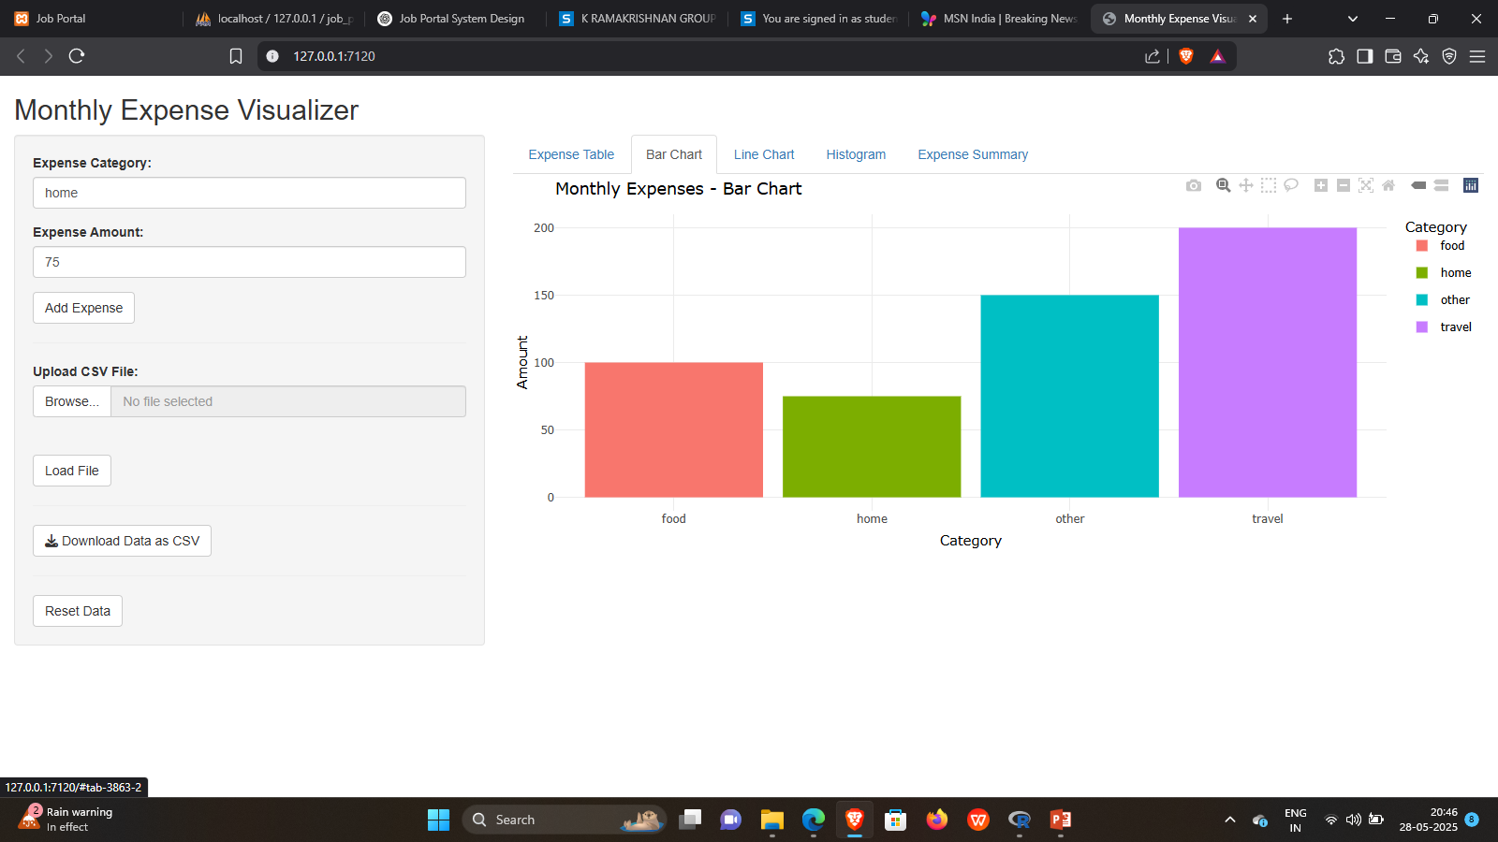
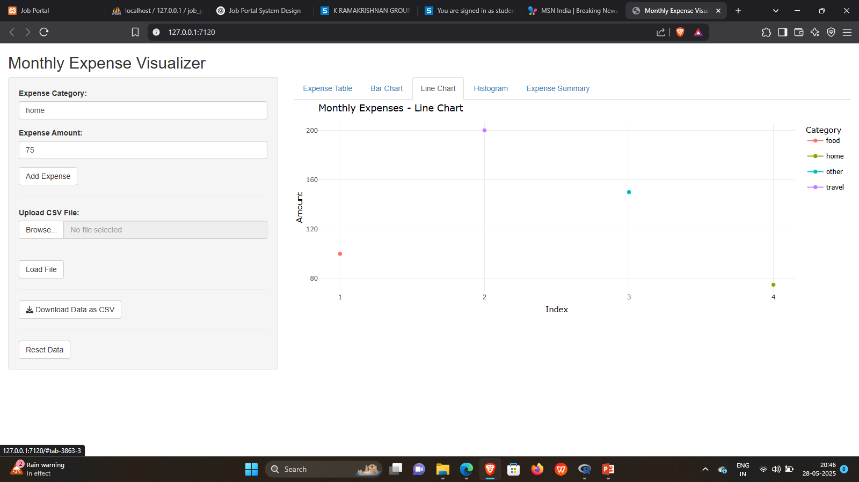
SCREENSHOTS
BARCHART
LINE CHART
13
29/05/2025

Slide 14
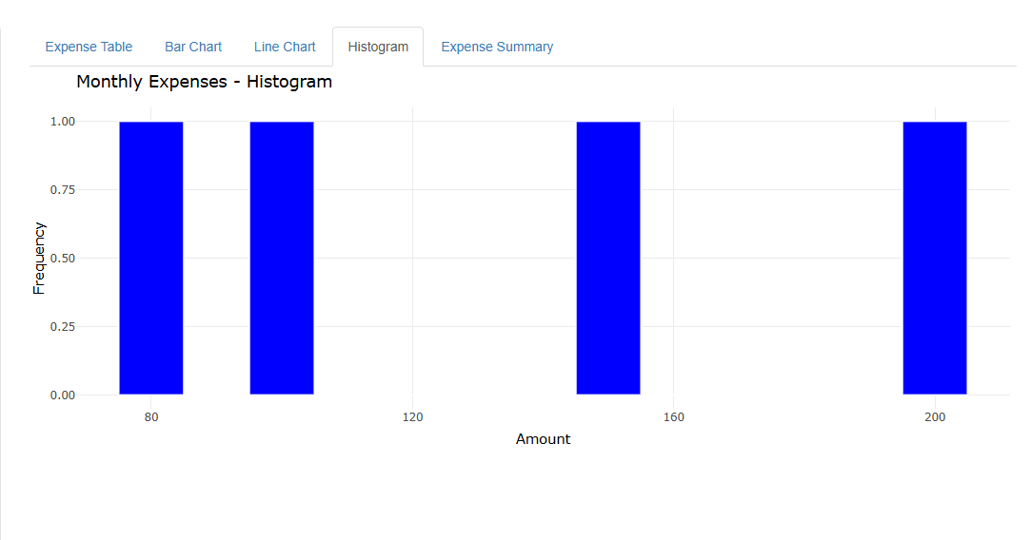
SCREENSHOTS
HISTOGRAM
14
29/05/2025

Slide 15
CONCLUSION
The app offers a simple and effective way to track monthly expenses through interactive visualizations, enhancing financial awareness. Its dynamic and user-friendly design helps users make informed budgeting decisions with ease.
The app simplifies monthly expense tracking with easy data upload.
Interactive visualizations help users understand spending patterns clearly.
Dynamic updates provide real-time feedback based on user input.
The modular design ensures scalability and ease of maintenance.
Overall, it promotes better budgeting and financial awareness for users.
15
29/05/2025

Slide 16
THANK YOU
29/05/2025

